Slide 1
GCom
GCom is a P2P system
All peers should have the same responsibility
There shouldn’t be a central component except for naming service
View synchrony is not required
Member that left the group can join as a new member
No need to store state data in a secondary storage
Java RMI doesn’t implement multicast
Iterate through the group view
No need to implement heartbeat
Failures can be detected during communication

Slide 2
GCom
No need to include UML diagrams conataining the classes
High level design diagram is sufficient
Message queues/buses such as JMS, ActiveMQ, ZeroMQ are not allowed
The debugger is important
Think about the debugger from the start

Slide 3
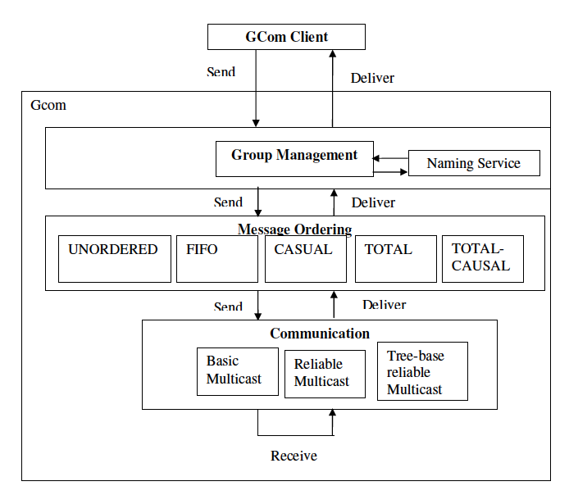
Gcom-Architecture
No need to include UML diagrams conataining the classes
High level design diagram is sufficient
Message queues/buses such as JMS, ActiveMQ, ZeroMQ are not allowed
The debugger is important
Think about the debugger from the start

Slide 4
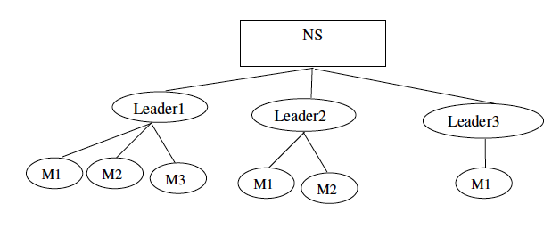
Gcom-Group Management

